Slide 1
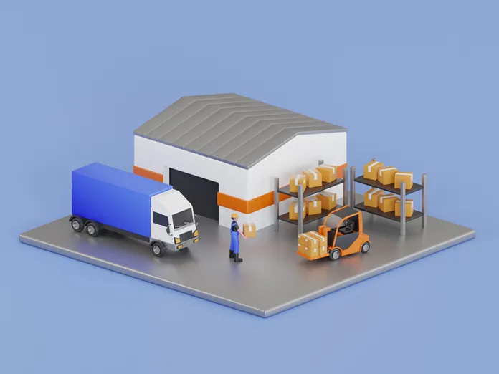
INTM 542/442, GROUP PROJECT- 3

Slide 2
NOVA VERTEX WAREHOUSE COMPANY | HOUSTON,TX
20 Products
A Items
B Items
C Items
Objective:
The primary objective for the Nova Vertex is to accommodate 20 products with using advanced techniques of warehouse storage.
We have products which have variable sales such as 1 million units , 300K units and 50K units for which we divided into categories A,B,C respectively.
We use reliable warehouse stocking techniques such as Narrow aisle racking , pallet aisle racking and push-back racking.
We have certain challenges to be taken into consideration:
Such as making sure to be able to stock items in shipping area for 1.5 days.
Able to store products in pallets for 1 hour from the time of it received.
To make sure to sort the area with the workforce we possess.
Adjust dispatch area requirements for 70% cubic efficiency in outbound shipments due to mixed products, ensuring optimal space utilization.

Slide 3
PROCESS FLOW
analysis of product details and demand
Calculations
picking strategies and storage methods
Footprint designs and layout of desings
Calculations of warehouse area

Slide 4
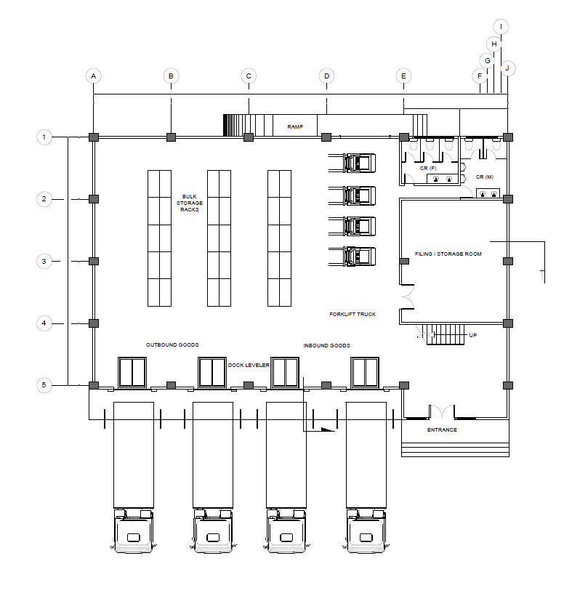
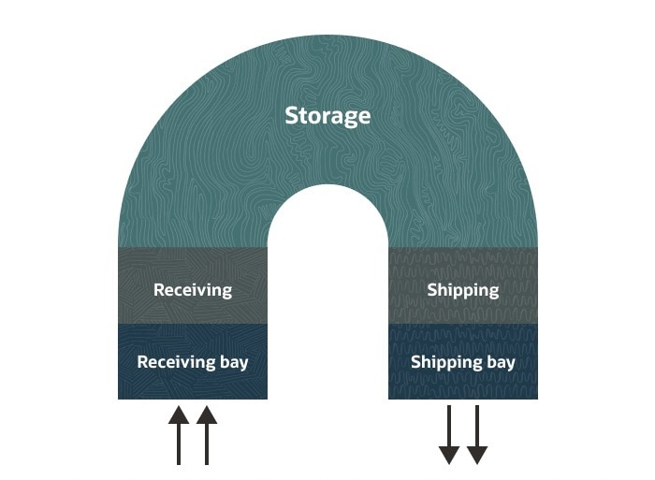
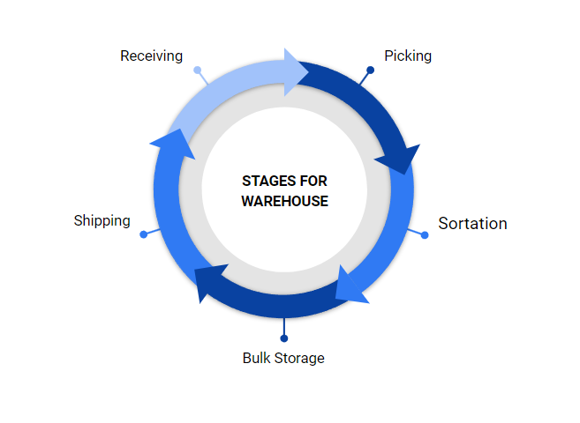
DESIGN
Footprint Layout
Workflow Process

Slide 5
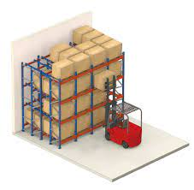
PALLET LIVE (FLOW RACK) STORAGE
A Products
Objective: Optimize A item inventory management with Pallet Live (Flow Rack) approach.
Racking Configuration: Specially designed racks with flow lanes for efficient access and organization.
Aisle Constraints: Aisle widths tailored for smooth movement of counter-balanced fork trucks.
Footprint Analysis:
Assessing space requirements to maximize storage area while accommodating fork truck movement.
The layout, aisle limits, and footprint allocation are crucial for an efficient Pallet Live (Flow Rack) storage solution for A items.
“A” Products are:
Smartphones
Water Bottles
Food Containers
Headphones
Printer Paper Sets

Slide 6
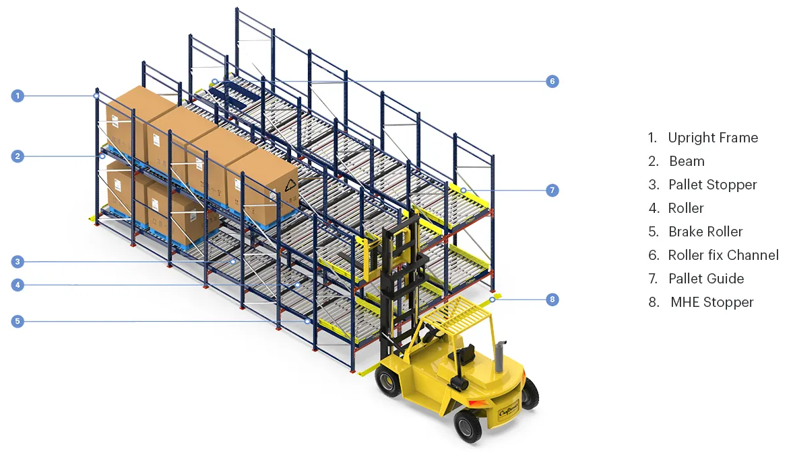
PALLET LIVE (FLOW RACK) STORAGE
B PRODUCTS: -
Television
Wearable Device
Laptops
Water purifier
Sunglasses
Storage Method: "Push-Back Racking System" Wheeled Cart and Rail Design: Pallets are placed on wheeled carts that fit onto slightly angled rails, facilitating smooth movement.
Depth of Storage: This system can store pallets 2 to 5 deep, enhancing space utilization in the warehouse.
Push-Back Mechanism: New pallets loaded from the front push existing pallets further back into the rack, optimizing storage space.
Ideal for Bulk Storage: Great for storing multiple pallets of the same item, allowing for high-density storage.

Slide 7
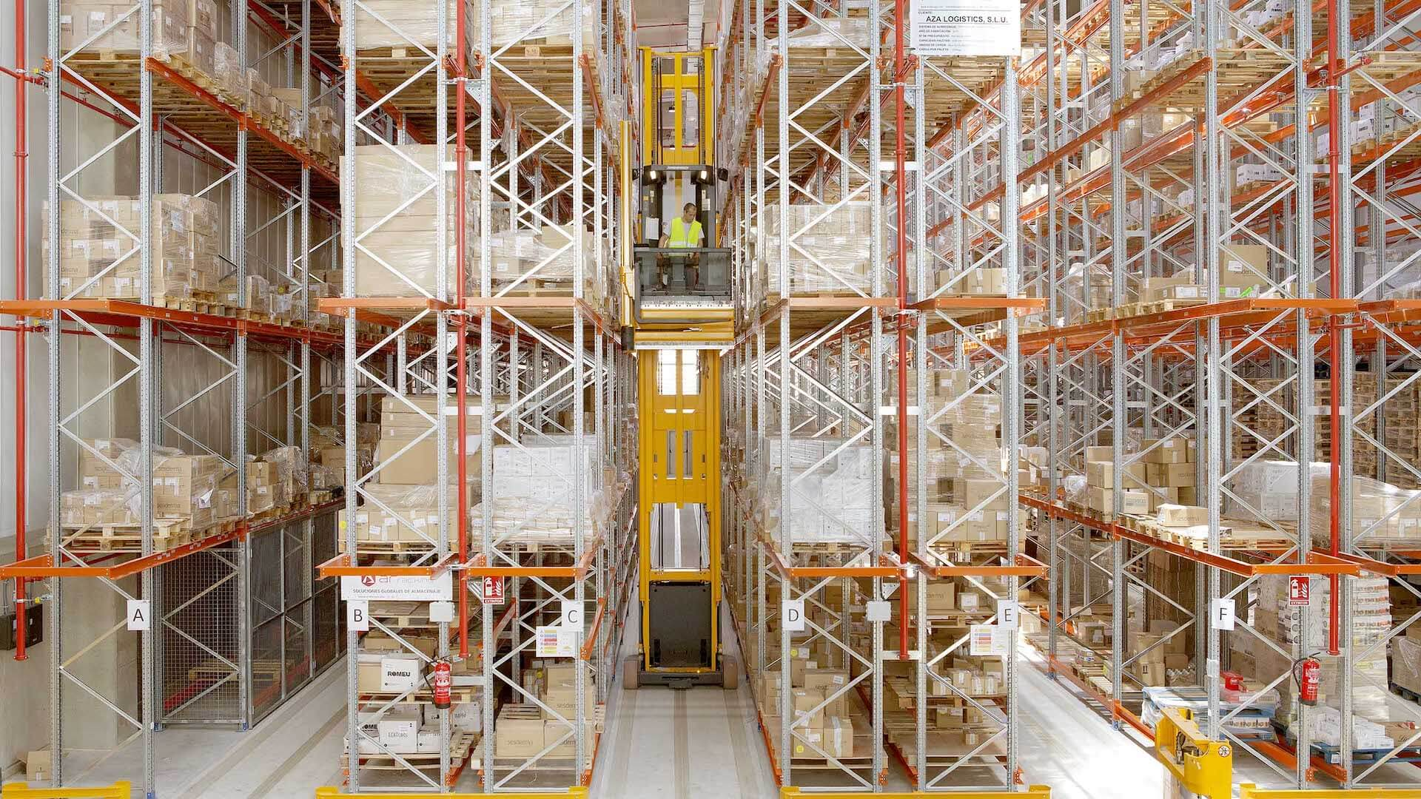
PALLET LIVE (FLOW RACK) STORAGE
C PRODUCTS: -
List of Items: Drones, Instant Pot, Coffee Maker, Hand-held Vacuum Cleaner, Speaker, Amazon Echo Dot, Throw Pillow, Wallet, Printer, Camera
Storage Method: "Narrow-aisle racking systems"
Description: Narrow-aisle racking systems have a substantial impact on aisle width due to their space-efficient design and the use of specialized narrow-aisle trucks for picking. Given the nature of the items and the storage system selected, the aisle requirements for this setup will be significantly reduced compared to traditional racking systems.

Slide 8
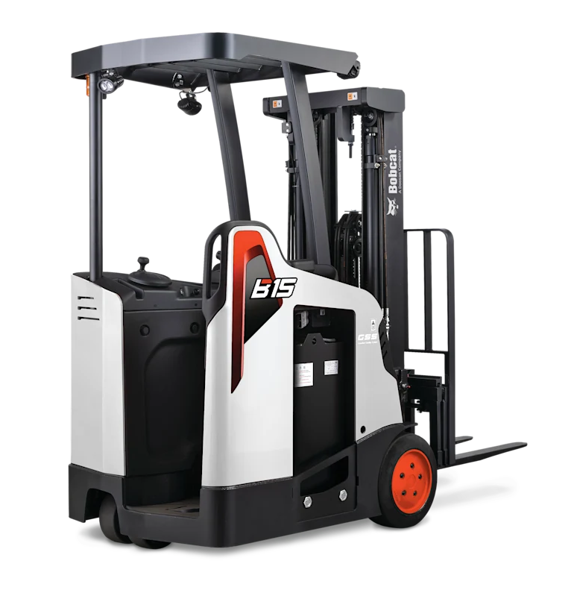
FORK LIFT
Frequency of Access: Particularly useful for items that are bulky or accessed frequently.
Suitable for Electronics: Ideal for storing electronic items like televisions and laptops due to its easy access and space efficiency.
Equipment Selection: "Reach Truck for Pallet Retrieval"
Specially Designed for Narrow Aisles: Ideal for the tight spaces in push-back racking systems. High Shelf Accessibility: Capable of reaching and retrieving pallets from high shelves. Efficient Handling: Enables quick and efficient movement and placement of pallets. Safe for Compact Environments: Ensures safety in densely packed storage areas. Ideal for Push-Back Racks: Well-suited for the specific demands of push-back racking systems.
AISLE REQUIREMENT: - Aisle width should be approximately 8 to 10 feet (2.4 to 3 meters) to allow enough space for the reach truck to makeover comfortably
Aisle flooring
Aisle marking
Aisle lighting

Slide 9
WHY NARROW-AISLE RACKING IS PREFERRED TO POWERED MOBILE RACKING:
Narrow-Aisle Racking
Compare
Powered Mobile Racking
1
Minimize space
Higher storage density
Minimize space
Higher storage density
2
lower initial investment
Less maintenance expenses
Higher initial investment
Higher maintenance expenses
3
Faster travel speed
Slower picking speed
Slower travel speer
Slower picking speed

Slide 10
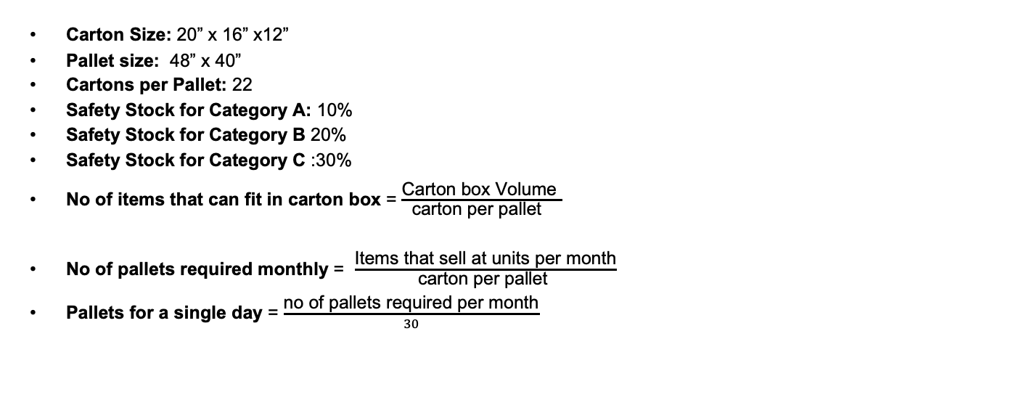
PALLET REQUIREMENTS
Carton Size: 20” x 16” x12”
Pallet size: 48” x 40”
Cartons per Pallet: 22
Safety Stock for Category A: 10%
Safety Stock for Category B 20%
Safety Stock for Category C :30%
No of items that can fit in carton box = $\frac{\text{Carton} \text{box} \text{Volume} }{\text{carton} \text{per} \text{pallet} }$
No of pallets required monthly = $\frac{\text{Items} \text{that} \text{sell} \text{at} \text{units} \text{per} \text{month}}{\text{carton} \text{per} \text{pallet} }$
Pallets for a single day = $\frac{\text{no} \text{of} \text{pallets} \text{required} \text{per} \text{month}}{30}$

Slide 11
DEMAND FOR EACH CATEGORY OF PRODUCT
Category | Demand per Month | Demand Per Day | Demand For 1.5 Day
A | 5 M | 166,666.65 | 25,0000.00
B | 1.5 M | 50,000.00 | 75,000.00
C | 0.5 M | 16,666.00 | 24,999.00

Slide 12
PALLET REQUIREMENT
Pallets Required Per Month: 34341
Pallets Required Per Day: 1534
Pallets Required Per Hour: 72
Upon Checking with the Safety Stock: 38,000

Slide 13
RECEIVING AREA
The receiving area of the warehouse has a requirement of total 1149 pallets to accommodate the daily demand of 20 products.
Taking the Safety Stock into consideration, we require a total of 1534 pallets in total per day.
Category | Monthly Demand | Daily Demand | Pallets/Day
A | 5M | 166,666.65 | 224
B | 1.5M | 50,000.00 | 703
C | 0.5M | 16,666.00 | 222

Slide 14
SORTATION AREA & BULK STORAGE AREA
Sortation Area:
For the Sortation Area, we need to consider the following
Number of Shifts= 2
Duration For each shift = 8 hrs
Total Working hours per day = 2x8 =16
Pallets per hour = Daily Pallets 16
The Sortation Area is calculated on the number of operation hours each day per employee and which is summed to 72 palettes. For all the products that require less than 1 pallet, we adjust them in the safety stock requirement as the pallets will change often.
The Bulk Storage area is designed to hold each product for one month, for which we require 34341 pallets per month, which has a utilization factor of 80% in the warehouse.

Slide 15
SHIPPING AREA
The shipping area in the warehouse should be capable of holding the products for at most 1.5 days. We need to have 2502 pallets in the warehouse to satisfy the needs. Considering the safety stock of each product category, the total number of pallets required in the warehouse is 3084.
Category | Monthly Demand | Daily Demand | For Holding 1.5 days | Pallets/Day
A | 5M | 166,666.65 | 250,000 | 0336.00
B | 1.5M | 50,000.00 | 75,000 | 1054.50
C | 0.5M | 16,666.00 | 24,999 | 1111.50

Slide 16
THANK YOU

